Slide 1
Introduction to NoSQL Databases
Database Management Systems
RDBMS (Relational Database Management Systems)
OLAP (Online Analytical Processing)
NoSQL (Not only SQL)
A database Management System provides the mechanism to store and retrieve the data
NoSQL databases were created to overcome the limitations of relational databases.

Slide 2
Introduction to NoSQL Databases
What is a NoSQL database?
NoSQL databases are different than relational databases like MQSql. In relational database you need to create the table, define schema, set the data types of fields etc before you can actually insert the data. In NoSQL you don’t have to worry about that, you can insert, update data on the fly.
One of the advantage of NoSQL database is that they are really easy to scale and they are much faster in most types of operations that we perform on database. There are certain situations where you would prefer relational database over NoSQL, however when you are dealing with huge amount of data then NoSQL database is your best choice.

Slide 3
Introduction to NoSQL Databases
Limitations of Relational databases
In relational database we need to define structure and schema of data first and then only we can process the data.
2. Relational database systems provides consistency and integrity of data by enforcing ACID properties (Atomicity, Consistency, Isolation and Durability ). There are some scenarios where this is useful like banking system. However in most of the other cases these properties are significant performance overhead and can make your database response very slow.

Slide 4
Introduction to NoSQL Databases
What are the advantages of NoSQL?
High scalability: NoSQL database such as MongoDB uses sharding for horizontal scaling. Sharding is partitioning of data and placing it on multiple machines in such a way that the order of the data is preserved. Vertical scaling means adding more resources to the existing machine while horizontal scaling means adding more machines to handle the data. Vertical scaling is not that easy to implement, on the other hand horizontal scaling is easy to implement. Horizontal scaling database examples: MongoDB, Cassandra etc. Because of this feature NoSQL can handle huge amount of data, as the data grows NoSQL scale itself to handle that data in efficient manner.
High Availability: Auto replication feature in MongoDB makes it highly available because in case of any failure data replicates itself to the previous consistent state.

Slide 5
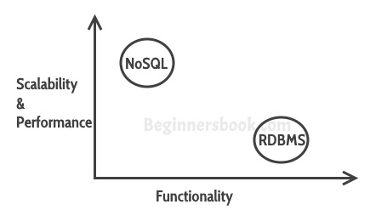
Introduction to NoSQL Databases
RDBMS Vs NoSQL
RDBMS: It is a structured data that provides more functionality but gives less performance. NoSQL: Structured or semi structured data, less functionality and high performance. 1. You can’t have constraints in NoSQL 2. Joins are not supported in NoSQL These supports actually hinders the scalability of a database, so while using NoSQL database like MongoDB, you can implements these functionalities at the application level.

Slide 6
Introduction to NoSQL Databases
When to go for NoSQL?
When you want to store and retrieve huge amount of data.
The relationship between the data you store is not that important
The data is not structured and changing over time
Constraints and Joins support is not required at database level
The data is growing continuously and you need to scale the database regular to handle the data.

